Slide 1



Garbage Classification Using
EfficientNetV2B2

Slide 2

Learning Objectives
Understand Real-World Image Classification Problems
Preprocess and Load Image Datasets Efficiently
Handle Class Imbalance and Improve Accuracy
Apply Transfer Learning with EfficientNetV2B2
Train, Evaluate, and Save Deep Learning Models
Generate Predictions and Export as CSV
Deploy Model with Gradio Web Interface
GOAL

Slide 3
Tools and Technology used
Machine Learning / Deep Learning
TensorFlow/Keras : Frameworks used to build, train, and evaluate the image classification model.
EfficientNetV2B2 : A powerful and efficient convolutional neural network used as the model backbone.
Data Handling and Preprocessing
NumPy : For handling numerical operations and array transformations.
Matplotlib : For visualizing training accuracy, loss, and evaluation metrics.
CSV : Used to save and manage custom prediction results in tabular format.
Dataset & Directory Management
OS module : Helps in navigating file directories and managing image files.
TensorFlow Dataset Utility : Automatically loads and splits image data into training and validation sets.
Deployment & UI
Gradio : Creates a simple web interface to allow users to upload images and get real-time predictions.

Slide 4
Methodology
Data Collection & Preprocessing:
Collected images from the Garbage Classification dataset. Resized images to 128x128 pixels. Normalized pixel values for better model performance.
Train-Validation Split:
Dataset split into 80% training and 20% validation. Used image_dataset_from_directory() from TensorFlow
Model Building (Transfer Learning):
Used EfficientNetV2B2 as the base model. Added custom dense layers for classification. Fine-tuned the top layers for better accuracy.
Model Training & Evaluation:
Trained the model for 10 epochs. Tracked training and validation accuracy & loss. Evaluated using precision, recall, and F1-score.
Custom Image Prediction:
Made predictions on new, unseen images. Saved outputs to a CSV file.
Deployment with Gradio:
Built an interactive web UI. Allowed users to upload an image and receive predicted garbage class in real time.

Slide 5
Problem Statement:
Manual garbage sorting is time-consuming, inefficient, and error-prone, leading to improper waste segregation.
Improper classification of waste results in increased environmental pollution, poor recycling efficiency, and added pressure on landfills.
There is a need for an intelligent system that can automatically and accurately classify different types of garbage like cardboard, glass, metal, paper, plastic, and trash.
The goal is to develop a deep learning-based solution that can automate the waste classification process using image inputs, improving speed, accuracy, and sustainability.

Slide 6
Solution:
Develop an AI-powered image classification system using deep learning (EfficientNetV2B2) to automatically identify and classify garbage into six categories: cardboard, glass, metal, paper, plastic, and trash.
Train the model on a labeled garbage image dataset, using TensorFlow/Keras to learn patterns and features of each waste type.
Evaluate the model using validation data and key metrics like accuracy, precision, recall, and F1-score to ensure reliable performance.
Deploy the solution using Gradio, allowing users to upload or drag-and-drop images of garbage and get instant classification results through a simple web interface.
This solution promotes faster, more accurate, and scalable waste management, supporting sustainability and environmental protection efforts.
Github Repository:- https://github.com/SriDeepthi328/Garbage_Classification_Using_EfficientNetV2B2

Slide 7
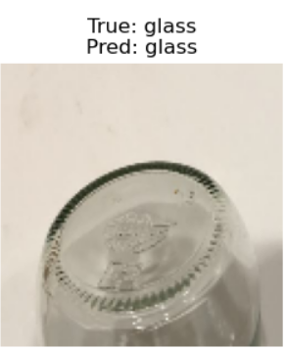
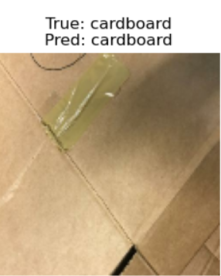
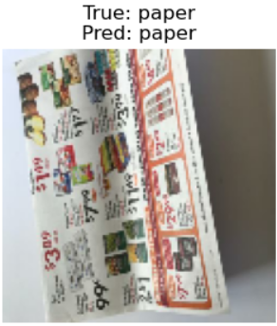
Screenshot of Output:

Slide 8
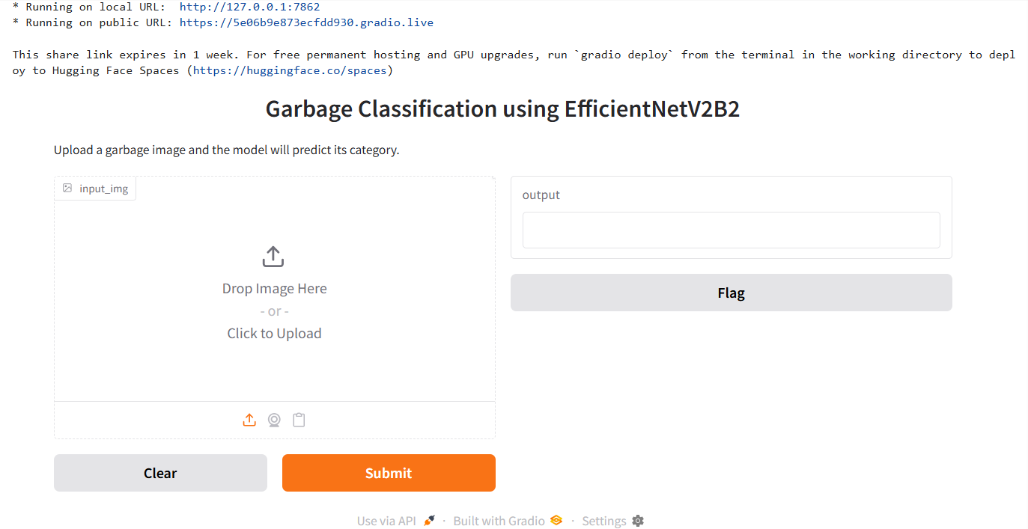

Slide 9
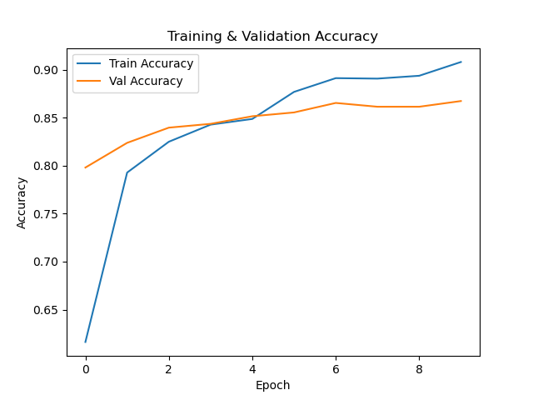
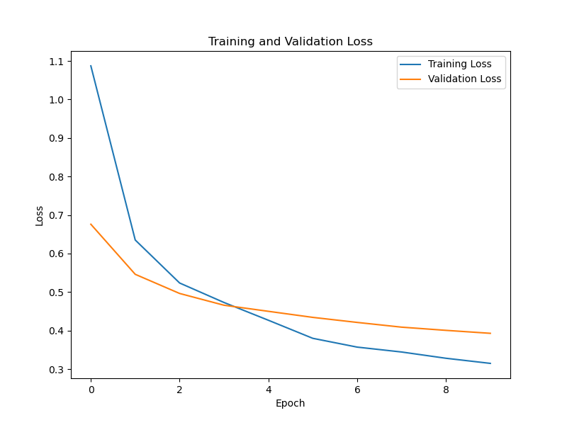
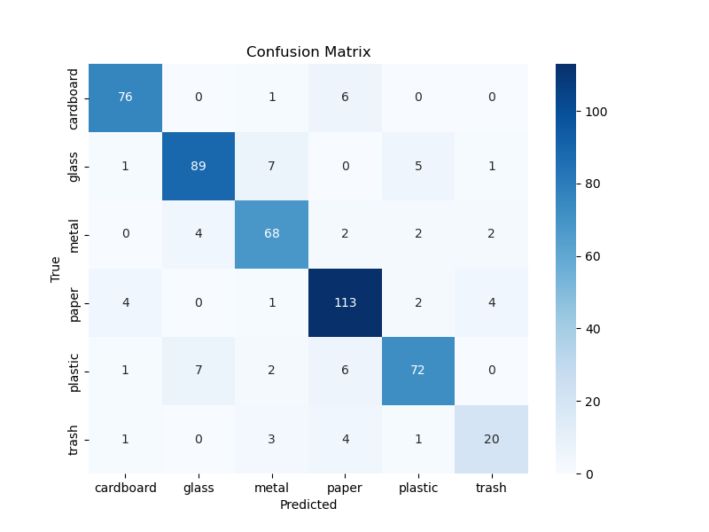

Slide 10
Conclusion
Project Summary:
This project successfully developed a garbage classification system using EfficientNetV2B2 and Transfer Learning, capable of identifying six types of waste: cardboard, glass, metal, paper, plastic, and trash.
Key Achievements:
Achieved 87% validation accuracy.
Successfully deployed a real-time prediction interface using Gradio.
Enabled prediction for custom and unseen images.
Demonstrated effective model evaluation using classification reports and confusion matrix.
Impact:
This system helps in automated waste sorting, supporting better recycling practices and reducing environmental pollution through AI-driven solutions.

Slide 11
THANK YOU!!!
Presented by:-
SRI DEEPTHI CHITTALA
AICTE Student ID: STU68341a35024b81748245045
AICTE Internship ID: INTERNSHIP_1746416864681834e0e35d8

